Slide 1
WEB MUSIC PLAYER
Team Name : Dev Tech
Team Number : 21
Team Members and Roll No.
1. Devansh Aggarwal (2210990258) – Leader / Coder
2. Devansh Bhagania (2210990259) – Coder
3. Devansh Shandilya (2210990261) – Coder
4. Devanshu Singh (2210990263) – Coder
5. Deepak (2210990249) – Coder

Slide 2
Index
• Introduction
• Objective
• Features Added
• Features
• Algorithm
• Tech Stack
• Result
• Source Code (screenshots)
• Conclusion
• References

Slide 3
Introduction
• Welcome to our project, a web music streaming platform based on Spotify.
• Our project aims to recreate the core functionalities of Spotify through a clone built using modern development tools.
• "Get ready to embark on a musical journey tailored just for you! Stay tuned as we unveil a music player designed to elevate your listening experience like never before."

Slide 4
Objective
• Objectives of our Project:
Develop a fully functional Spotify clone using React.js.
Integrate an API to fetch and display the music library dynamically.
Implement key features such as music playback, search option, add to queue, add or delete a playlist and user authentication.

Slide 5
Features Added
• Added a search option
• Added an option to create or delete playlists
• Added an option to queue music

Slide 6
Features
• Features of our Project:
Seamless music playback.
Music playback controls such as play, pause, skip, rewind, and volume control.
Access to your favorite music playlists and the ability to create or delete playlists.
A sleek and intuitive user interface enhancing the overall listening experience.
Music queuing.

Slide 7
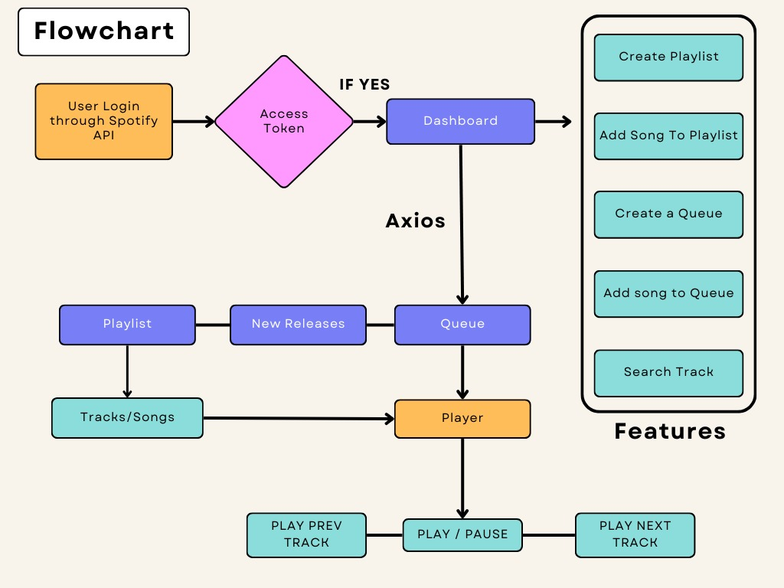
Algorithm

Slide 8
Tech Stack
• Frontend:
React.js : For building the user interface.
Context Hook : For state management.
React Router : For handling routing within the application.
Axios : For making HTTP requests to the Spotify API
• APIs:
Spotify API: For fetching user data, playlists, and music.

Slide 9
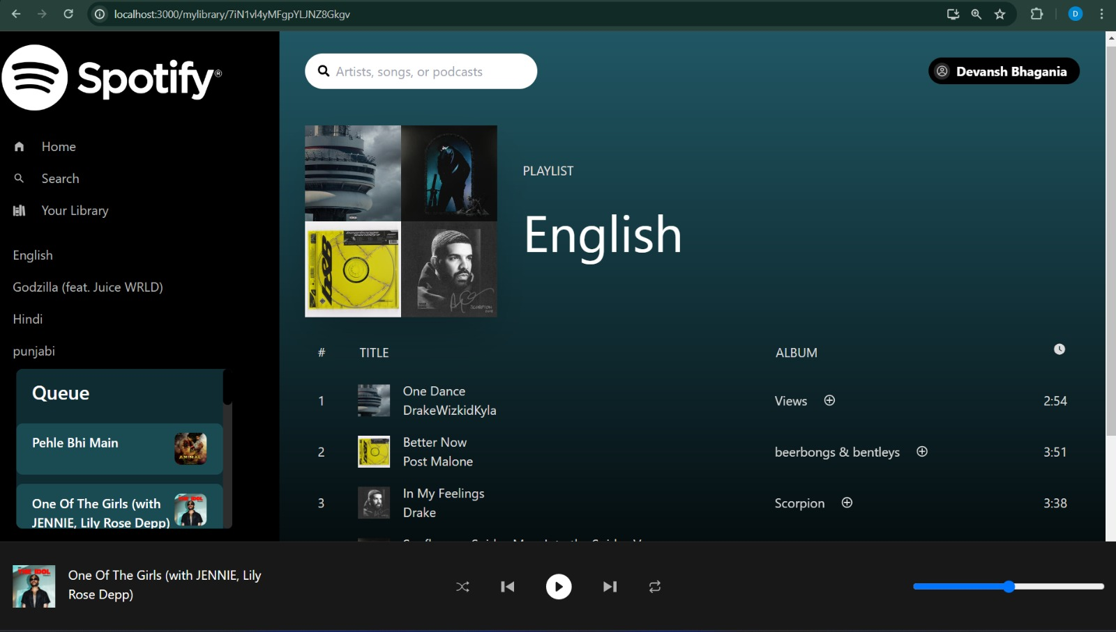
Result

Slide 10
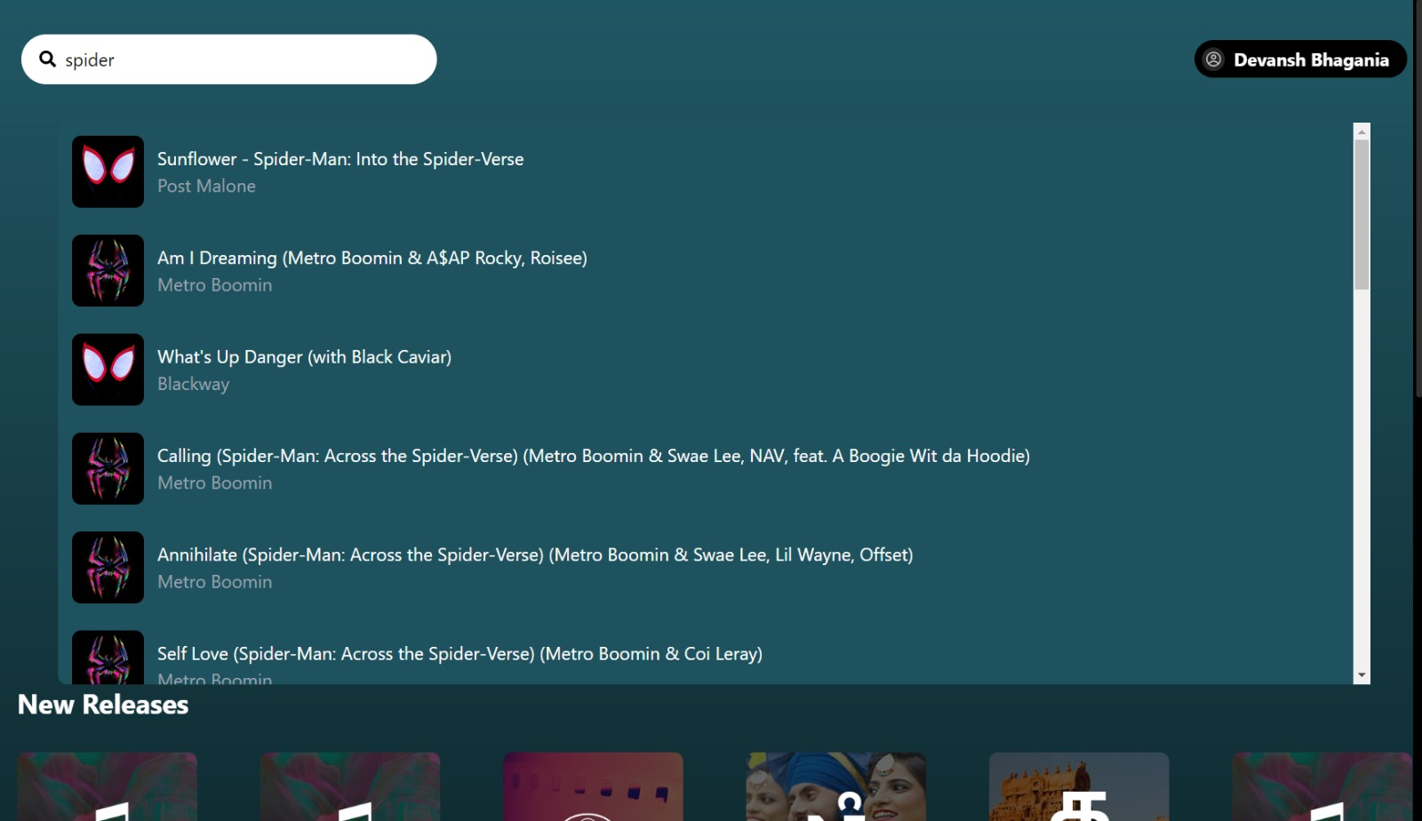
Result

Slide 11
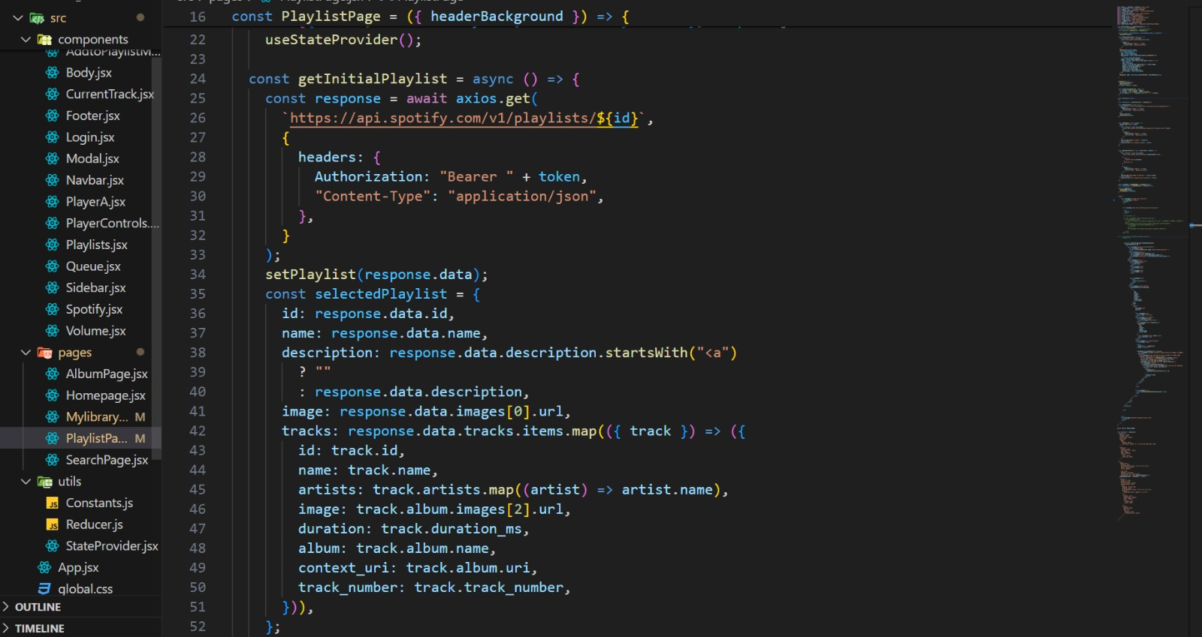
Source Code

Slide 12
Conclusion
In summary, our music player application, developed using React and seamlessly integrated with Spotify, has effectively fulfilled its mission of delivering a personalized and seamless music listening experience. The application's capability to showcase all albums within a user's Spotify library, play any track from their playlists, and effortlessly navigate between songs underscores its user-centric design philosophy."

Slide 13
Reference
https://www.w3schools.com/
https://legacy.reactjs.org/docs/getting-started.html
https://www.geeksforgeeks.org/.

Slide 14
Thank You

